Slide 1
Predicting trends in home sale prices
James Chiu
DSI - Capstone
April 9, 2018
Notes:
Hello

Slide 2

Introduction
Whether you are a real estate investor, homeowner, renter or government, housing is a part of the economy that affects everybody.
How do we make informed decisions about a basic need?
How can we predict trends in the housing market?
Can we use time series data to predict the price of a house?

Slide 3

Goals
Predict future home sales price 1-6 months ahead.
Does adding features relevant to the economy as a whole affect the accuracy of the model?
Eg. CPI, Fed Funds Rate, Unemployment Rate

Slide 4
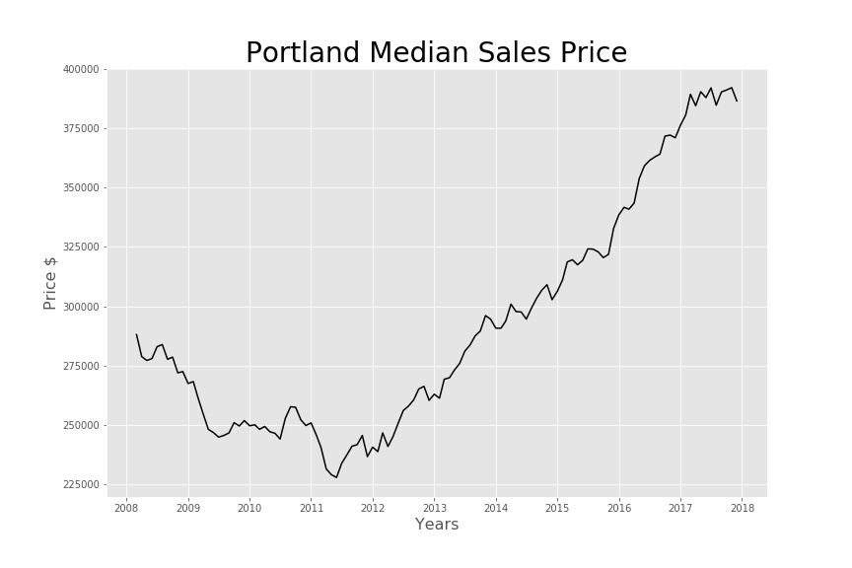
EDA
Zillow
Portland monthly data (118 observations)
Median Sales Price from Mar 2008 - Dec 2017

Slide 5
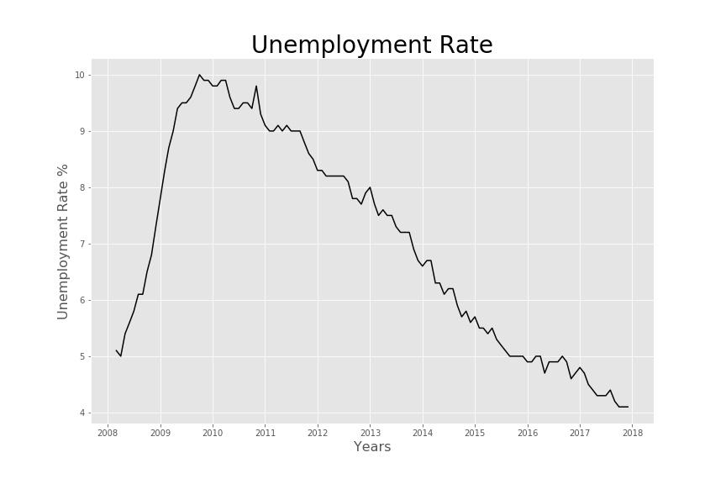
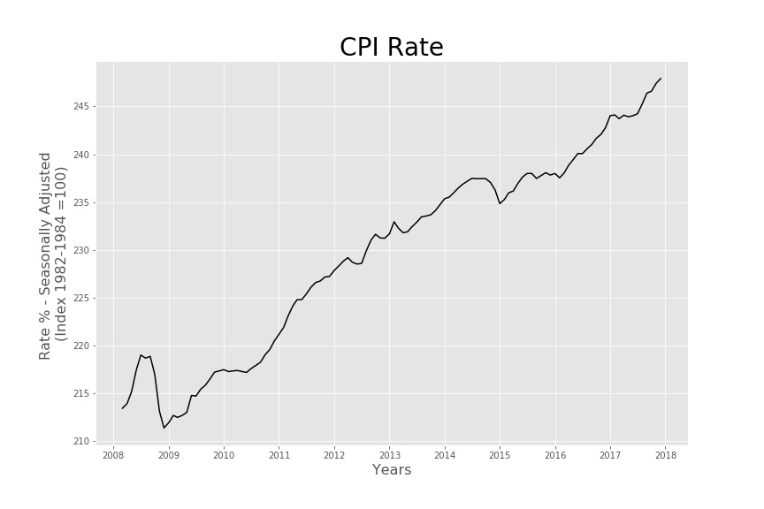
EDA
St. Louis Federal Reserve
CPI, Fed Funds Rate, Unemployment Rate
Features monthly data from Mar 2008 - Dec 2017

Slide 6
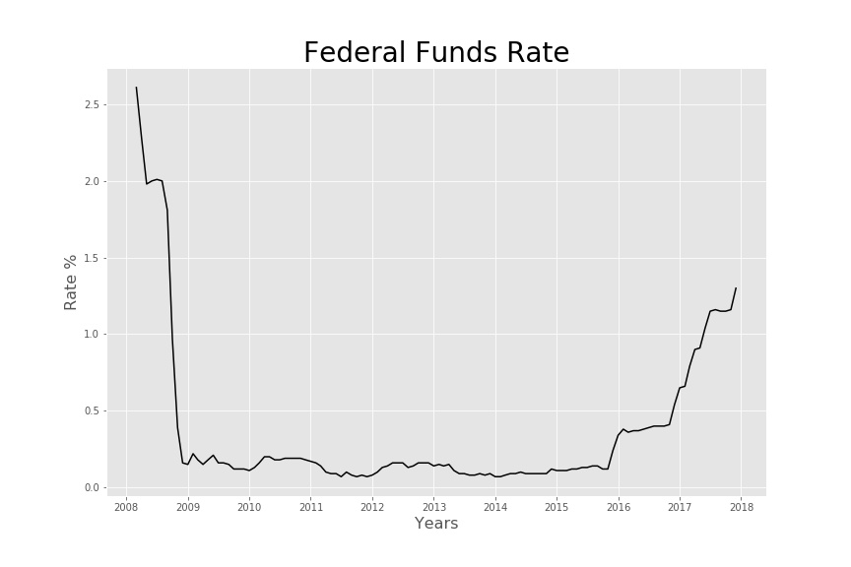

EDA

Slide 7
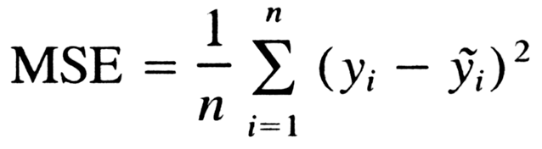
Success Metric: Mean Squared Error

Slide 8
Model: Time Series
6 months Portland median housing price data to
predict 1 month ahead (baseline)
Model | Error (derived from MSE)
Linear Regression | $ 4,109.13
Neural Network | $ 2,350.77
LSTM - Recurrent Neural Network | $ 2,332.09

Slide 9
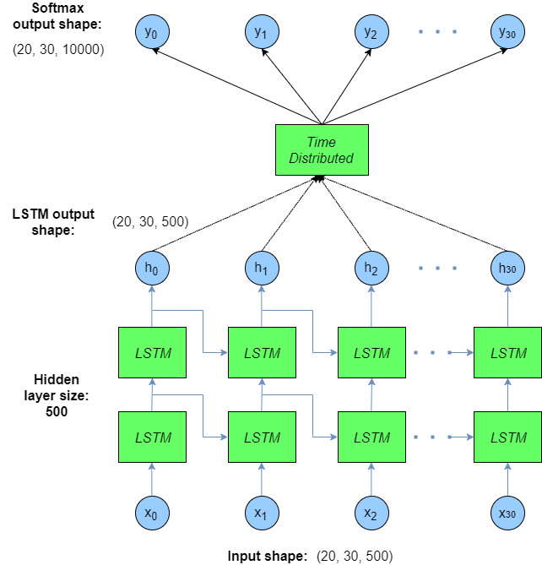

LSTM:

Slide 10
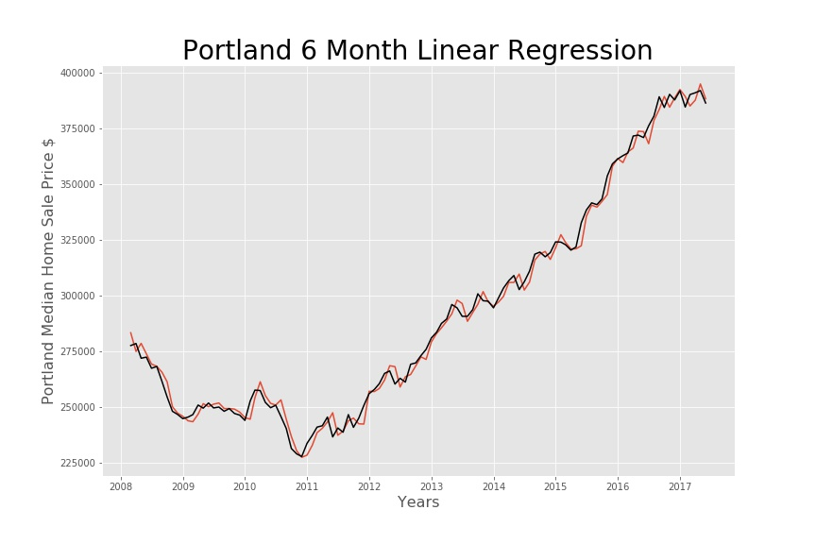
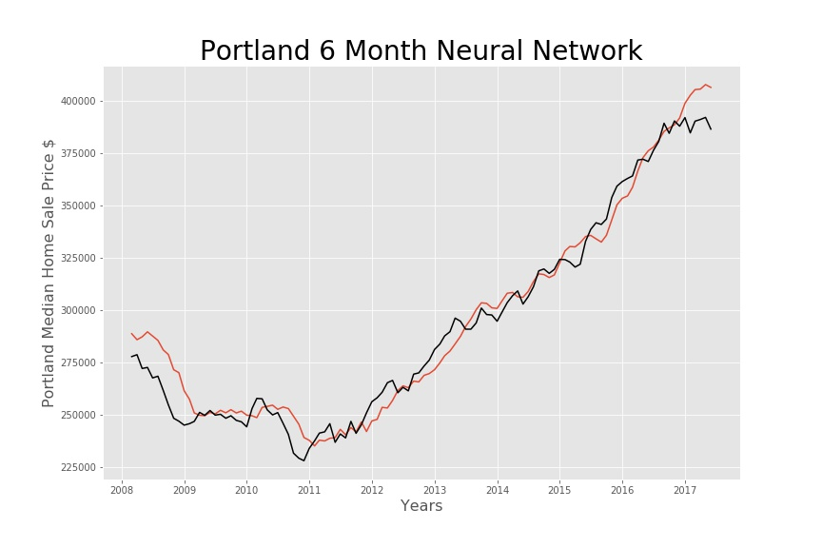
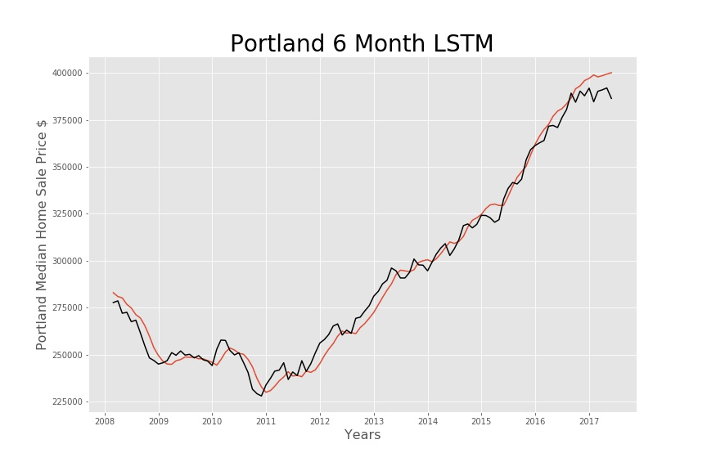

Slide 11
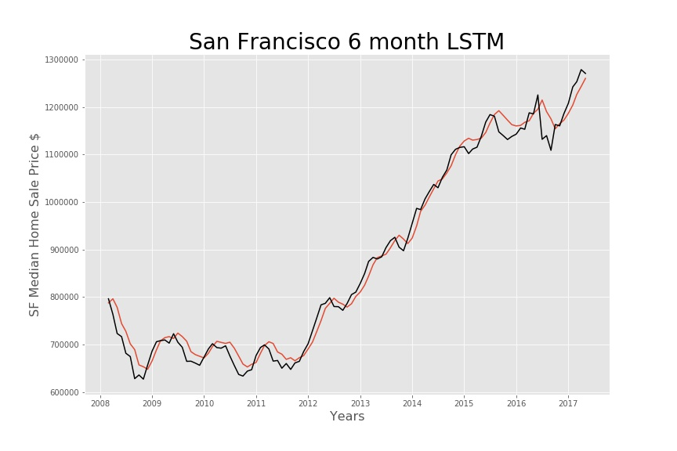

Slide 12
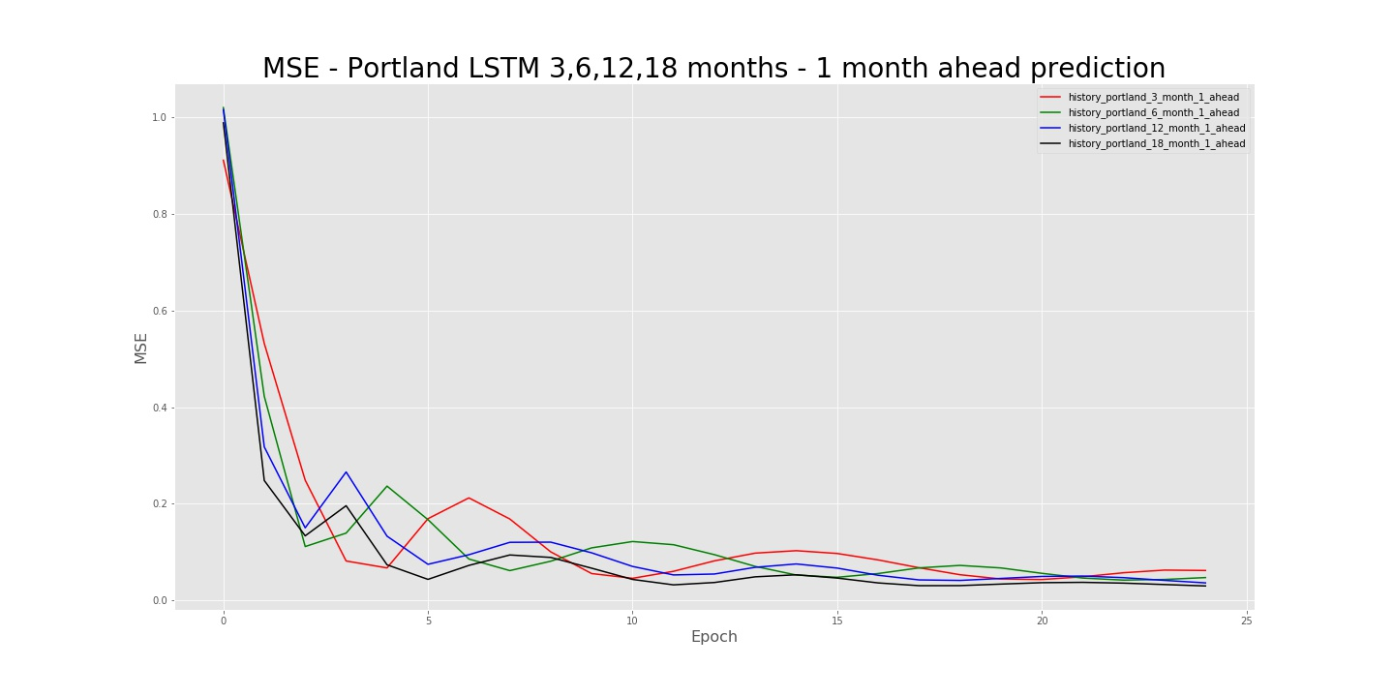
Model: LSTM increased features

Slide 13
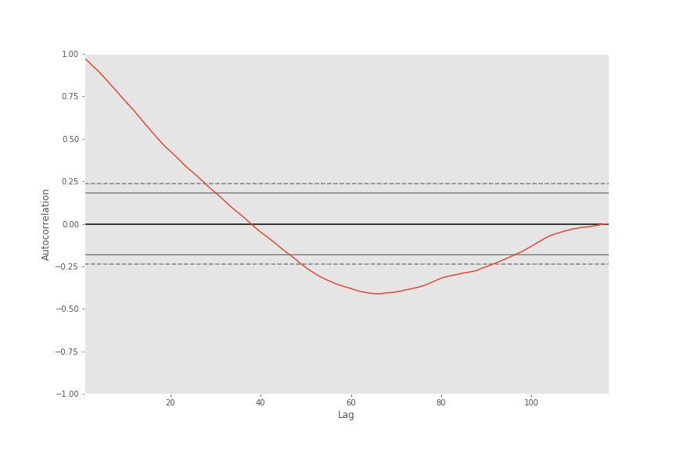
Impact of past prices on predicted price

Slide 14
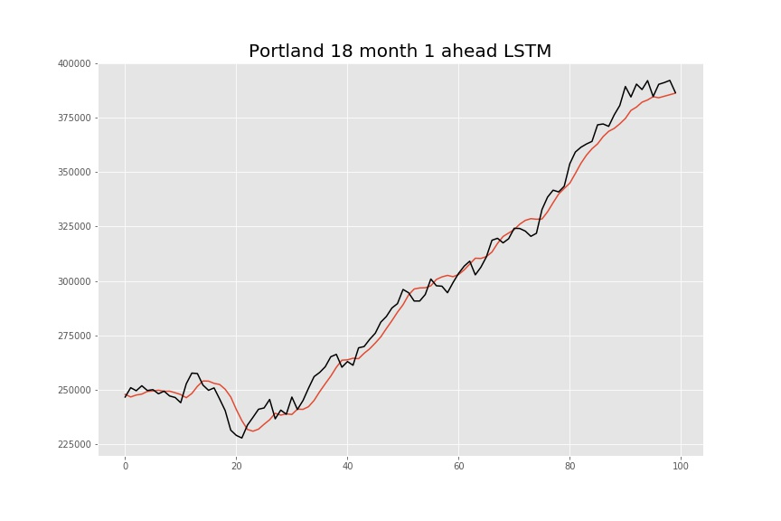
Model: LSTM 18 month 1 ahead

Slide 15
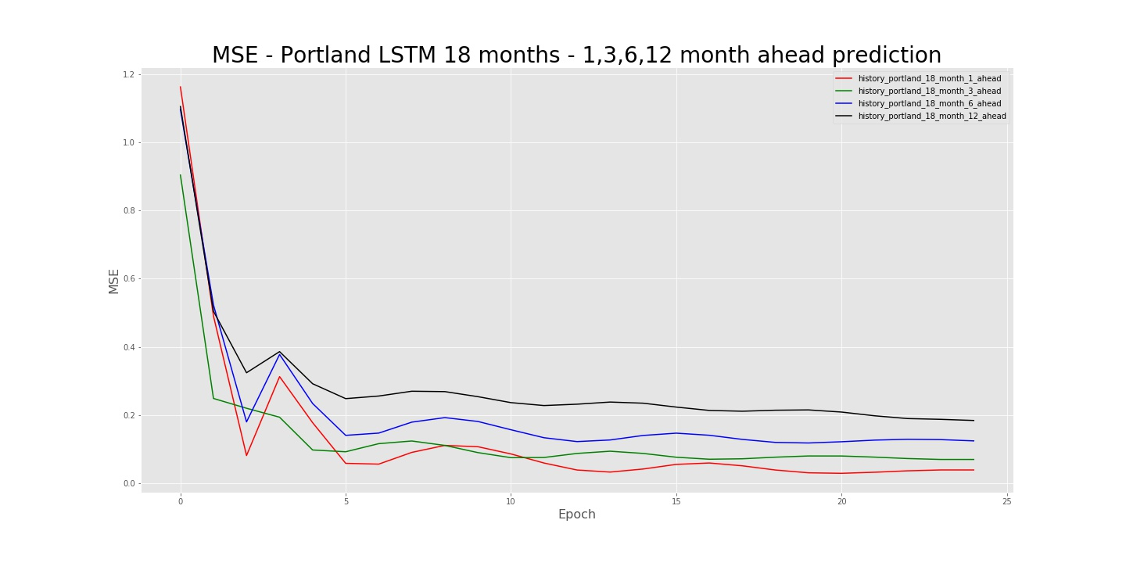
LSTM Predicting 1,3,6,12 months ahead

Slide 16
Data
CPI & Unemployment Rate
Monthly data from Mar 2008 - Dec 2017

Slide 17
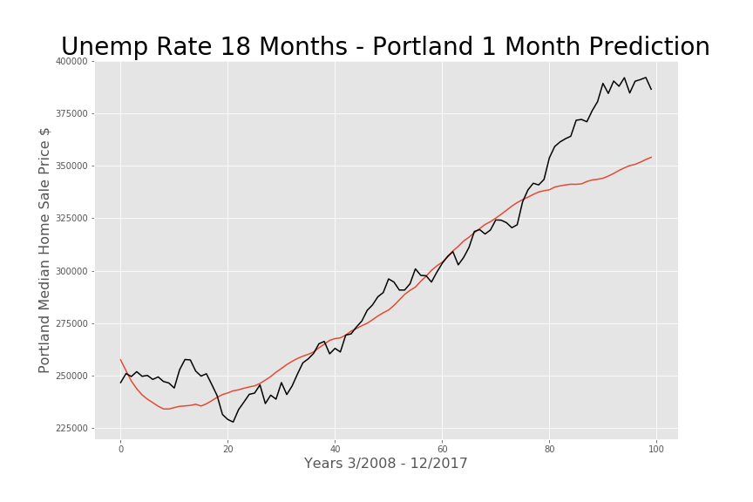
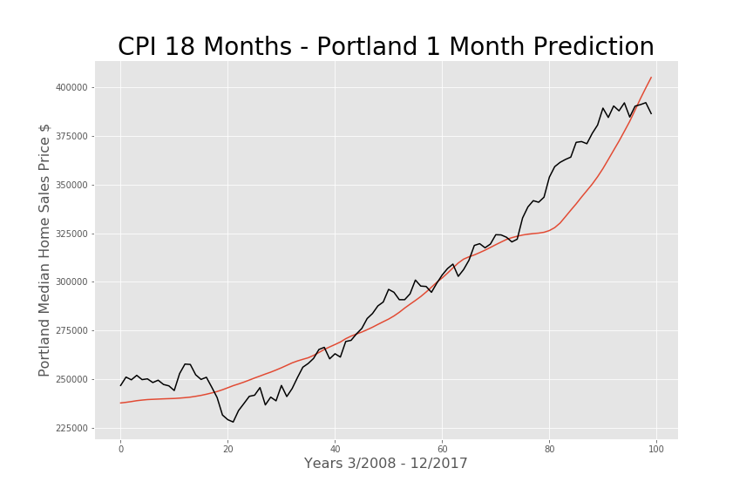
CPI & Unemployment Rate to predict: Portland 1 month ahead

Slide 18
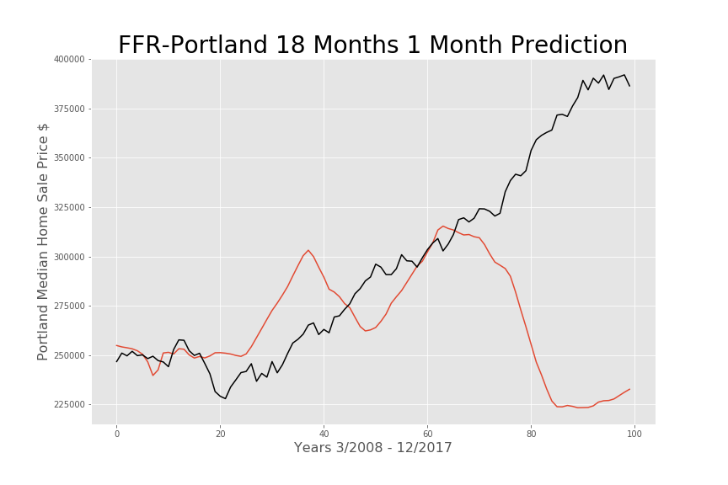
Fed Funds Rate to Predict:
Portland 1 month ahead

Slide 19
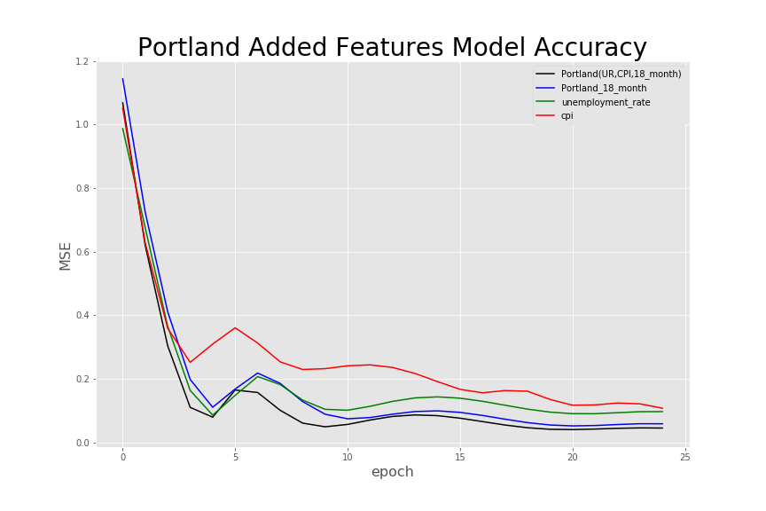
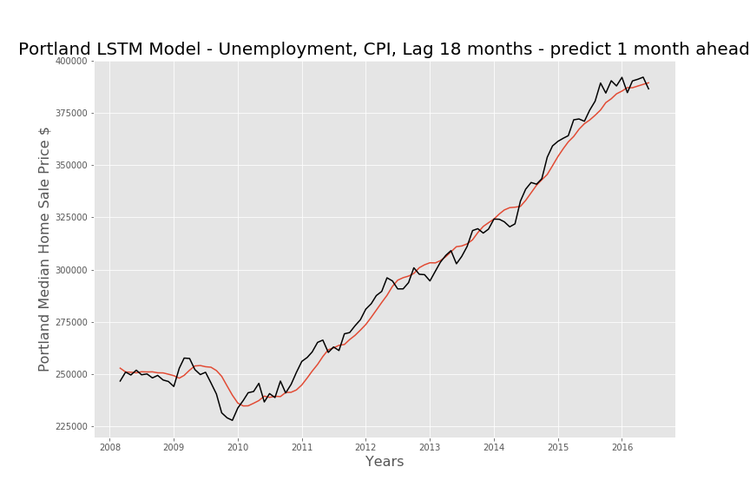
Combined Model
Efficient market hypothesis: Price fully reflects all available information

Slide 20

Conclusion
Best model: LSTM 18 months + CPI + UR
More months of data help, but limited by correlation
Predicting more months ahead widens error
Adding features helps reduce error, but not significantly
Efficient Market Hypothesis

Slide 21

Application:
Homebuyer:
Best time to buy?
Best price to bid?
Renter:
Best time to lock in a rental contract?
Government:
There is a upward trend in prices.
Increase the supply of homes?

Slide 22
Thank you

